Slide 1
Classes: An OO Design
Unit-08

Slide 2
Understanding Object-Oriented Programming (OOP) in C++17 involves diving into four fundamental concepts: Encapsulation, Inheritance, Polymorphism, and Abstraction

Slide 3
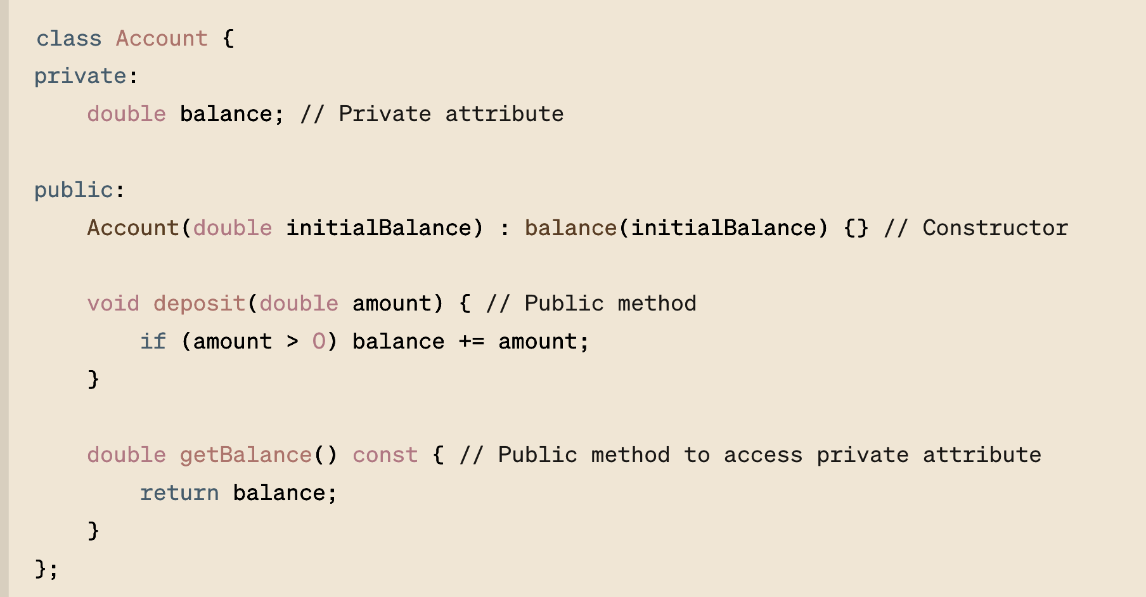
Encapsulation is about bundling the data (attributes) and methods (functions) that operate on the data into a single unit or class and restricting access to some of the object's components. This is achieved using access specifiers (private, protected, and public).

Slide 4
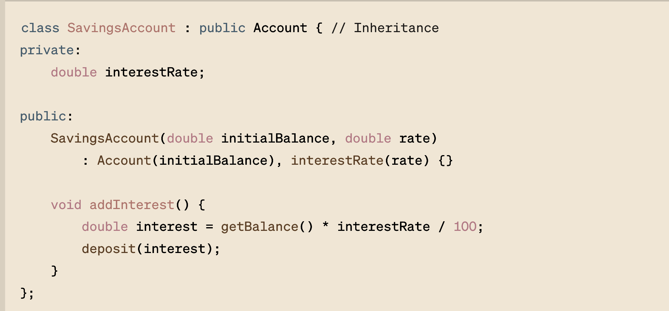
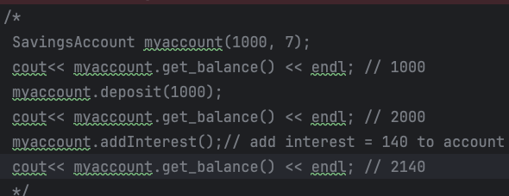
Inheritance allows you to create a new class (derived class) that reuses, extends, and modifies the behavior of another class (base class). This is a way to form a hierarchy of classes.

Slide 5
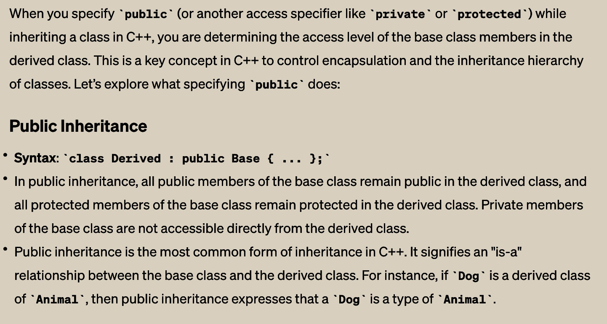
Inheritance allows you to create a new class (derived class) that reuses, extends, and modifies the behavior of another class (base class). This is a way to form a hierarchy of classes.

Slide 6
Inheritance allows you to create a new class (derived class) that reuses, extends, and modifies the behavior of another class (base class). This is a way to form a hierarchy of classes.

Slide 7
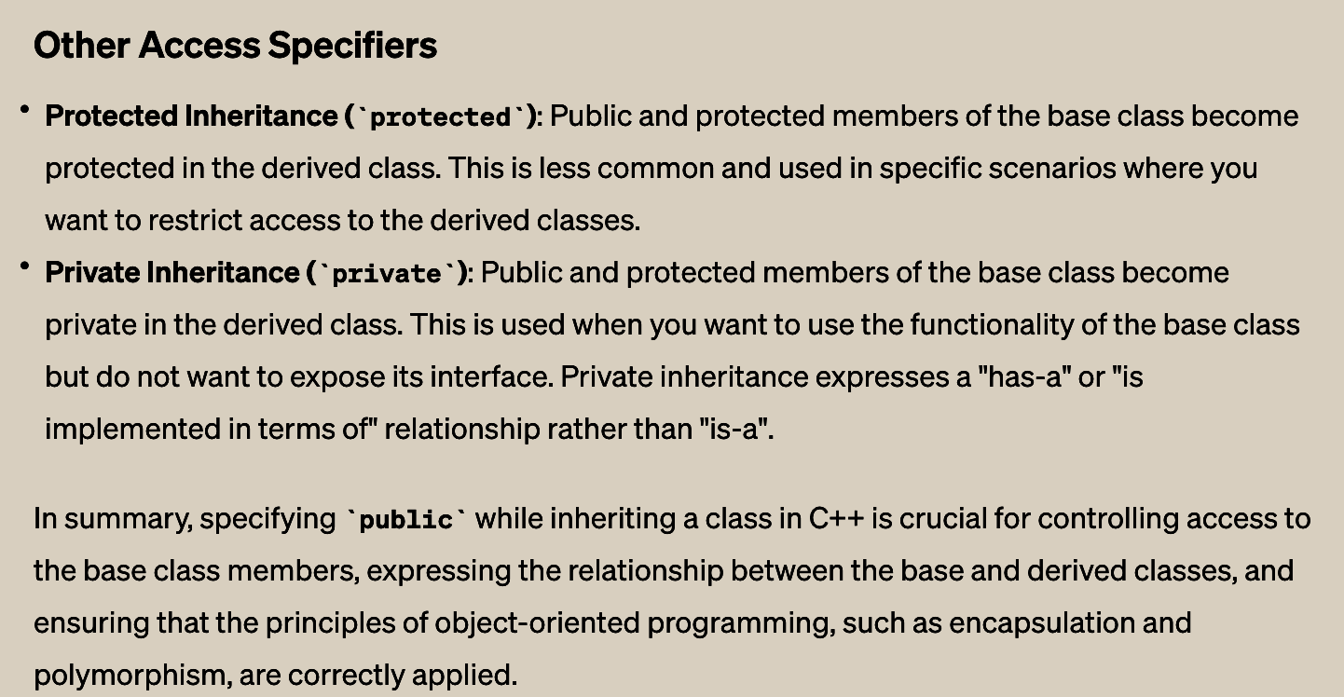
Inheritance allows you to create a new class (derived class) that reuses, extends, and modifies the behavior of another class (base class). This is a way to form a hierarchy of classes.

Slide 8
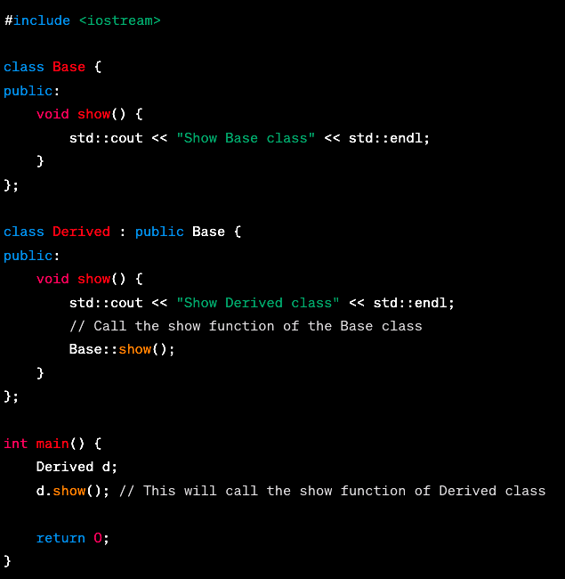
Inheritance method resolution.
In C++, if you want to call a function of a parent class instead of an overridden function in the current class, you can do so by explicitly specifying the parent class's name followed by the scope resolution operator (::) before the function name. This is useful in cases where you have a function in a base class that has been overridden in a derived class, but you still need to access the original version of the function from the derived class.

Slide 9
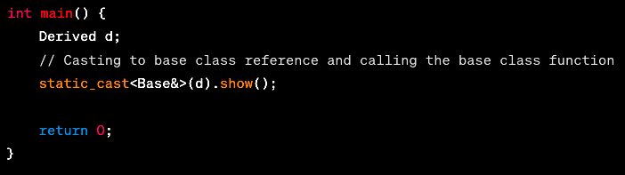
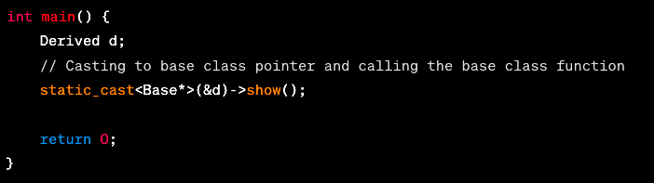
Inheritance method resolution.

Slide 10
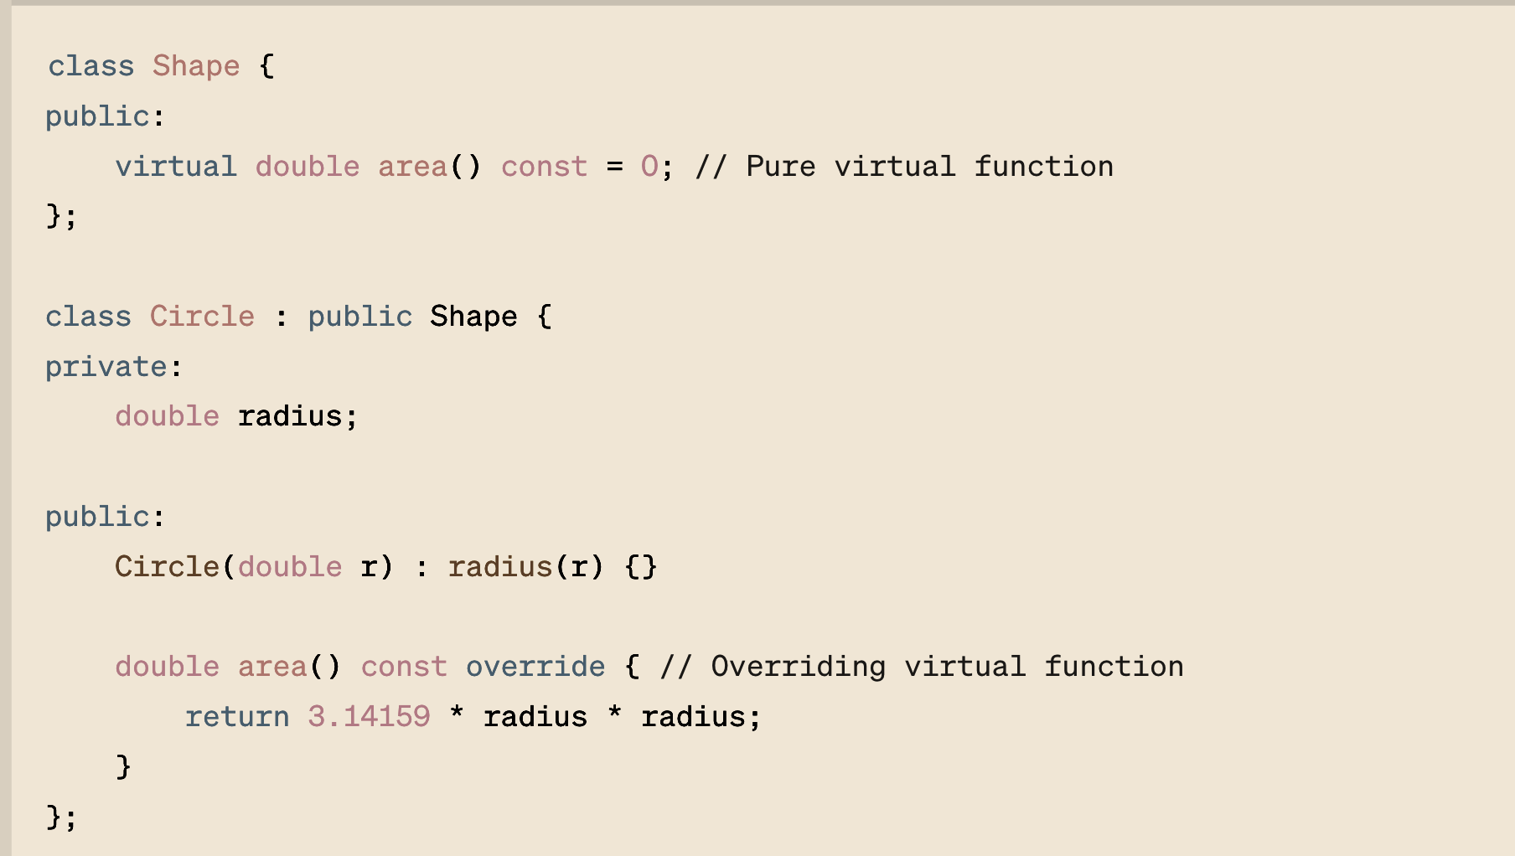
Polymorphism allows methods to do different things based on the object it is acting upon. This is mainly achieved through virtual functions and function overriding in derived classes.

Slide 11
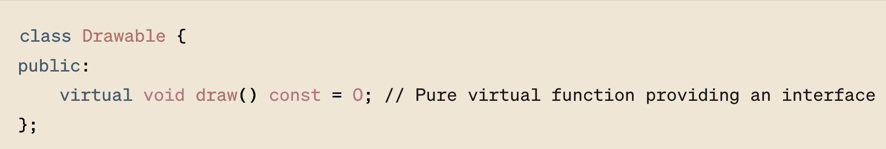
Abstractions is the concept of hiding the complex reality while exposing only the necessary parts. It’s more of a design principle that affects how you structure your classes and interfaces (abstract classes in C++).
What is pure/non-pure virtual function?

Slide 12
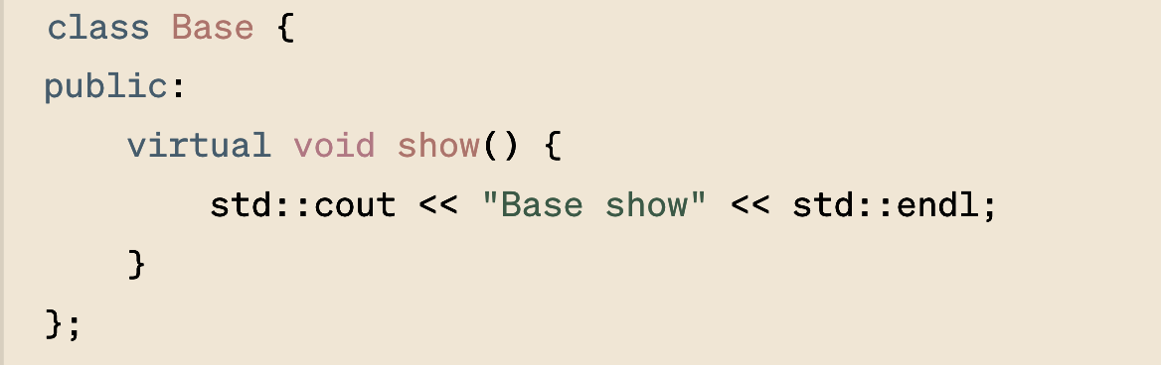
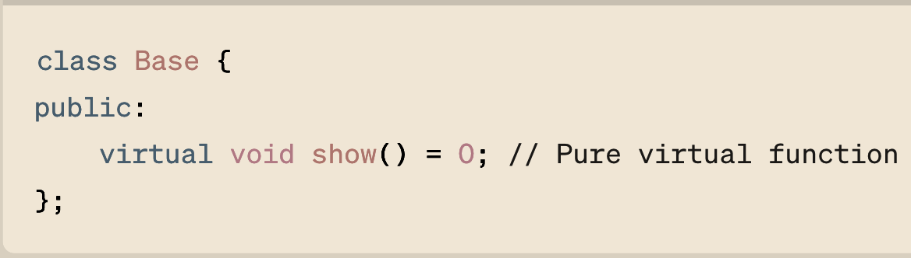
show is a non-pure virtual function because it has its implementation. Derived classes can override show, but if they don't, calling show on a derived class object will execute the Base class version.
show is a pure virtual function (denoted by = 0), and Base becomes an abstract class. Any class that derives from Base must provide an implementation for show to be instantiable.
What is pure/non-pure virtual function?

Slide 13
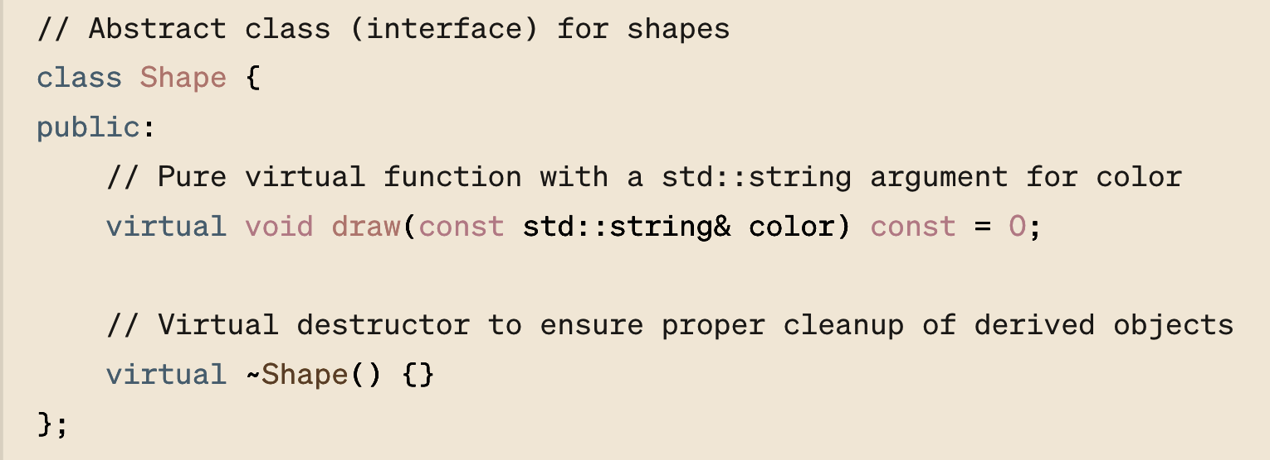
Abstractions is the concept of hiding the complex reality while exposing only the necessary parts. It’s more of a design principle that affects how you structure your classes and interfaces (abstract classes in C++).
An interface, in the context of object-oriented programming (OOP), is a concept that defines a contract within a system; it specifies a set of methods that a class must implement. Interfaces are about "what" actions can be performed, but they do not dictate "how" these actions are performed.

Slide 14
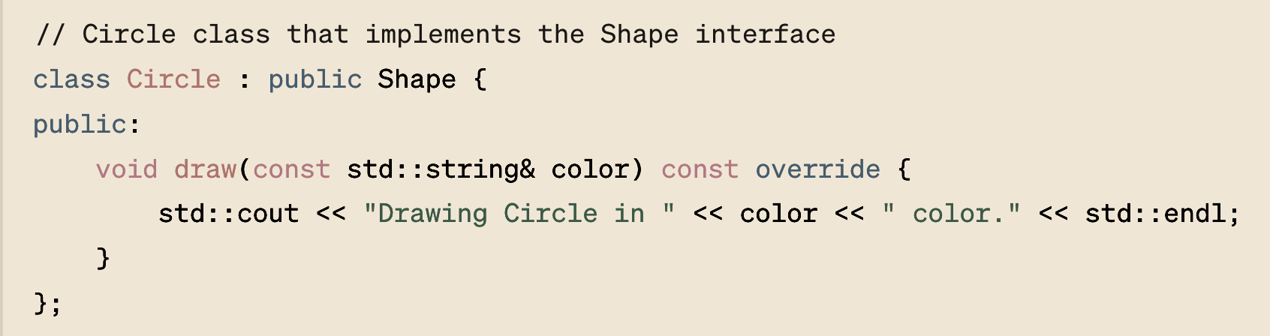
Abstractions is the concept of hiding the complex reality while exposing only the necessary parts. It’s more of a design principle that affects how you structure your classes and interfaces (abstract classes in C++).

Slide 15
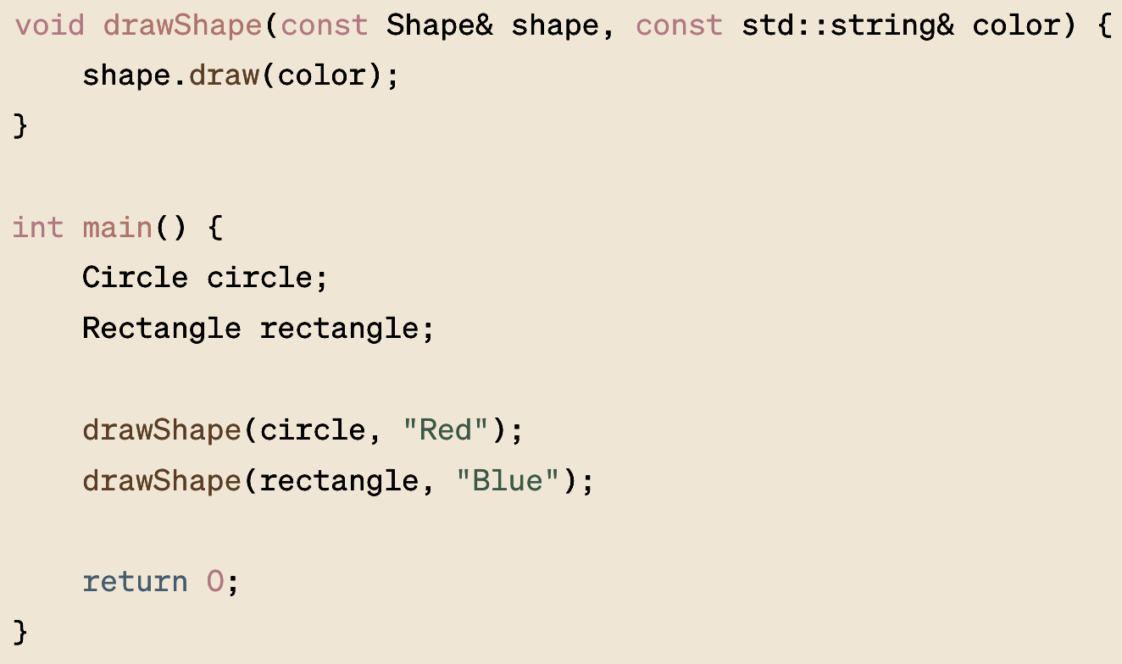
Abstractions is the concept of hiding the complex reality while exposing only the necessary parts. It’s more of a design principle that affects how you structure your classes and interfaces (abstract classes in C++).

Slide 16
Lets Test Our Skills

Slide 17
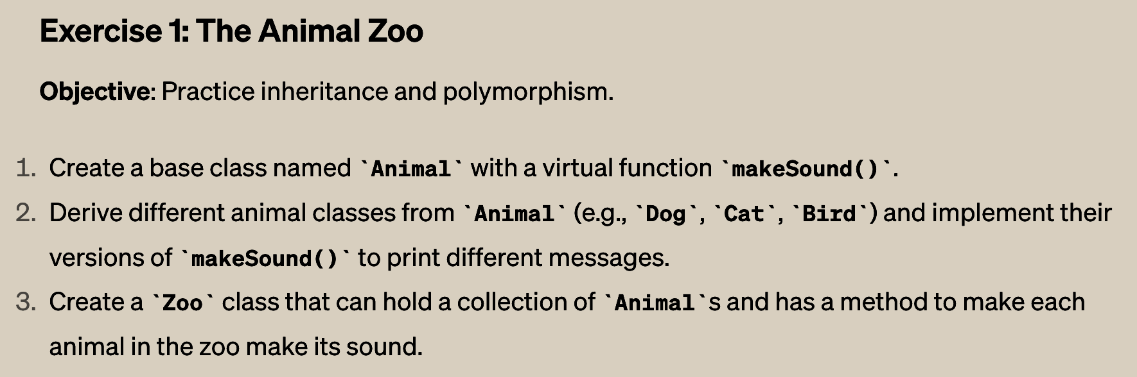

Slide 18
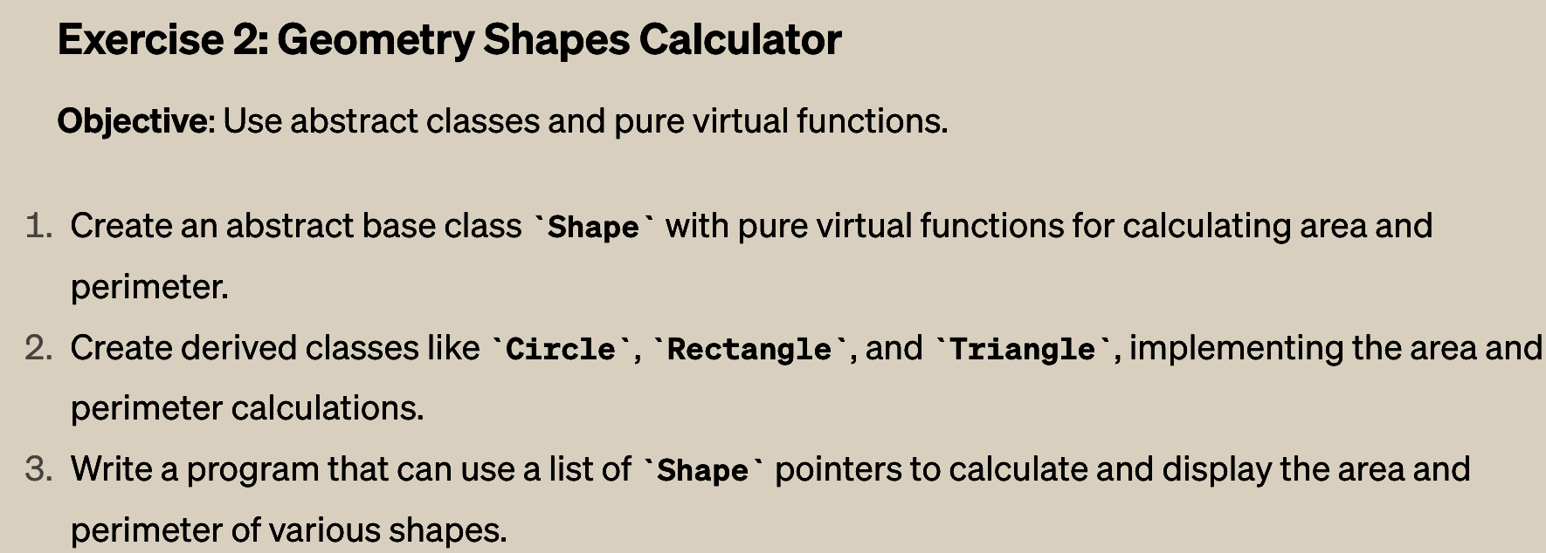

Slide 19
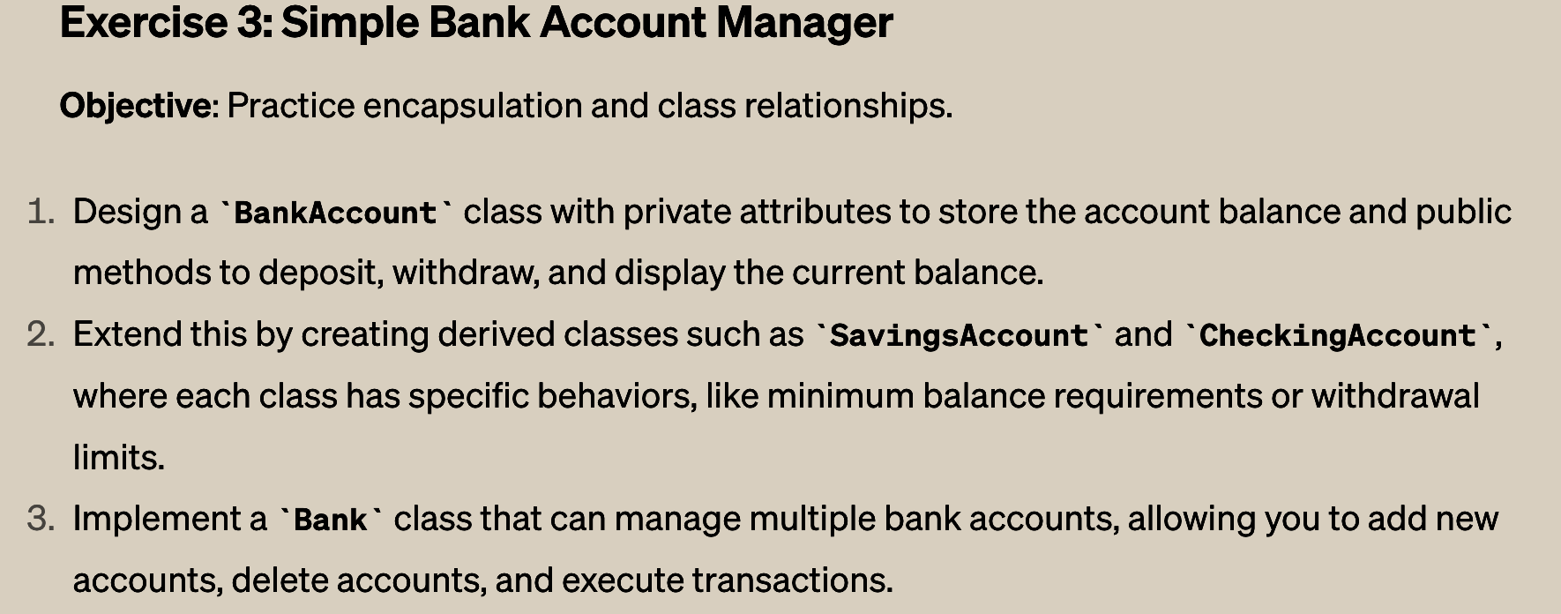

Slide 20
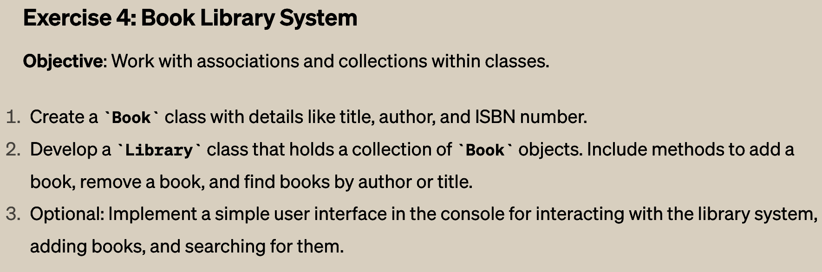

Slide 21
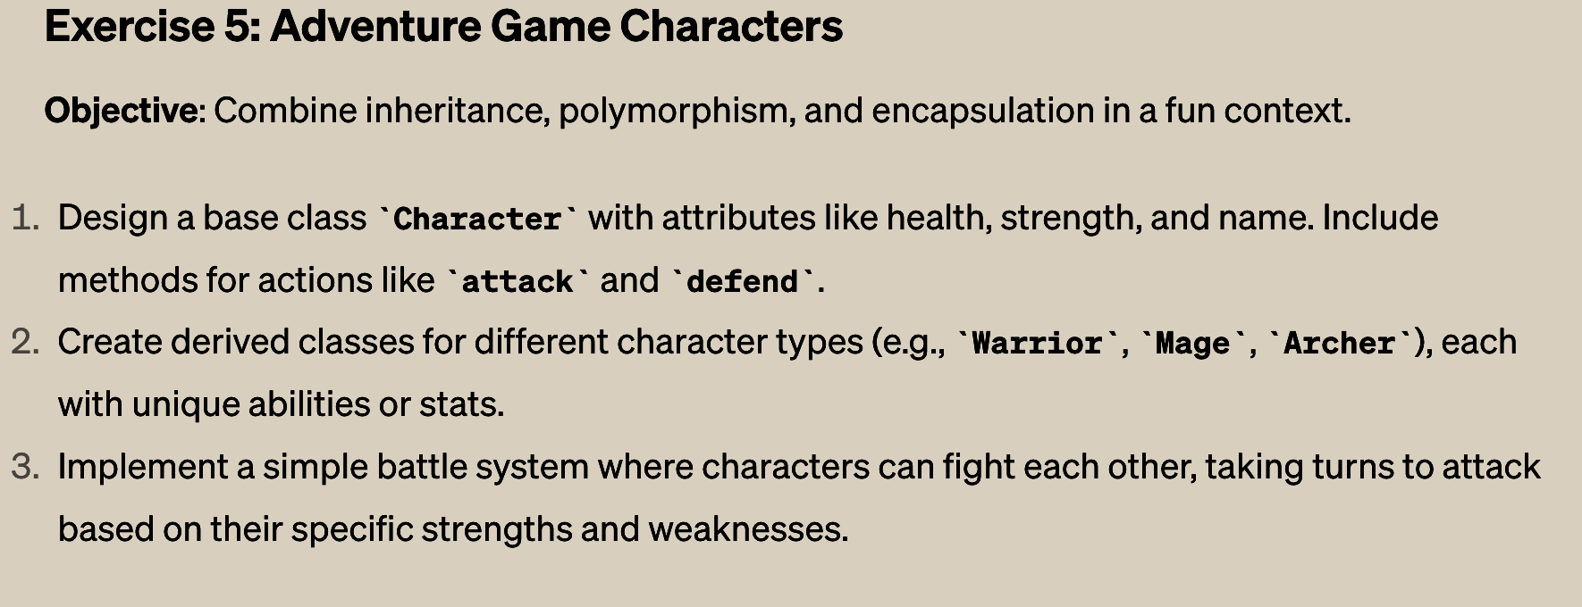

Slide 23
SELF STUDY
EXCEPTION HANDLING

Slide 24
SELF STUDY
EXCEPTION HANDLING
Exception handling in C++ is an essential feature that allows a program to deal with unexpected problems that might arise during its execution. By using exception handling, you can catch errors as they occur and handle them gracefully, potentially allowing the program to continue running instead of crashing.
In C++, exceptions are typically handled using a combination of three keywords: try, catch, and throw.

Slide 25
